Slide 1
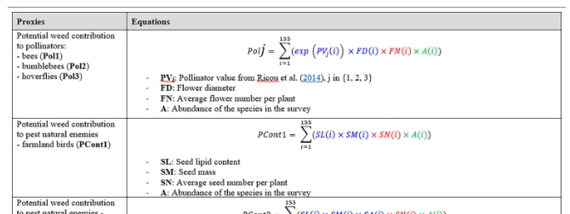
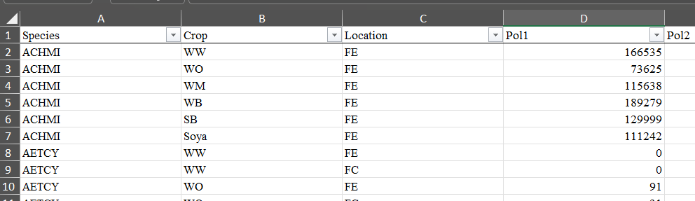
Table 2
Appendix, ‘Plant level’ tab
But what if I want just the value per plant? E.g., without multiplying by abundance?

